Slide 1
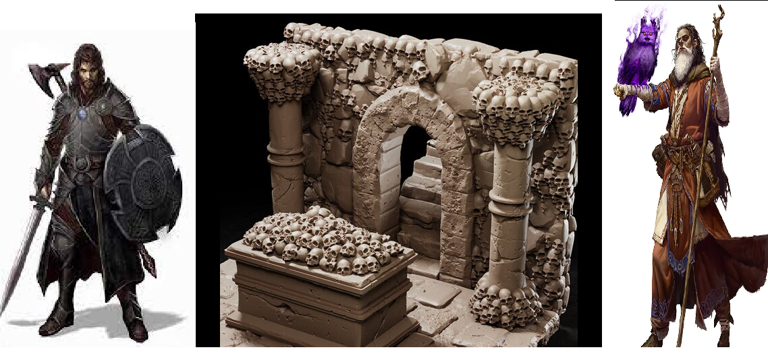
The Adventure of Salvatore
Pitch Date: October 22, 2023 Update November 19, 2023
Release Date: March 3, 2024 Commits: 57 (+18)
Team Lead: Vince McKeown 6 Contributor (+2)
1
2
3
4
5
6
7
8
9
10
11
12
13
14
15
16
17
18
19
23
30
39
57

Slide 2
Contributions This week -Vince McKeown
Levers open/close walls
Added keys/green pot
User Interface
WIP Combat – Sword Swing

Slide 3
Contributions This week -Michael Fewkes
Z-Sorting

Slide 4
Contributions This week -fizzybuzzybeezy
M to toggle Mute
Fixed source names
Tile Coin, Tile Potato Sack, ImageLoading

Slide 5
Contributions This week -Christer McFunkyPants Kaitila
Pixel Perfect
Background

